Slide 1
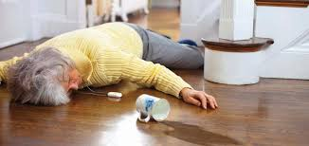
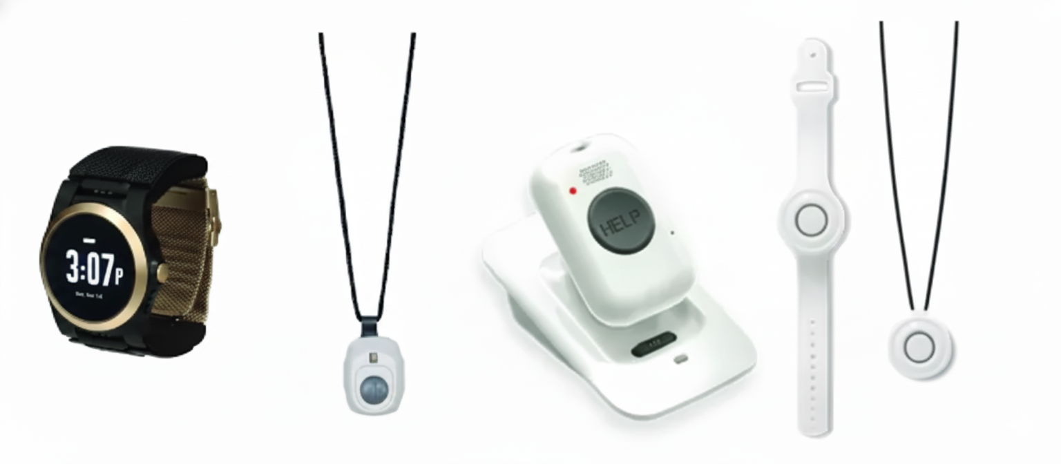
Needs Statement:
A way to reduce time-to-assist for unwitnessed falls for elderly individuals living in long term care homes that reduces the severity of adverse events and maximizes post-incident recovery outcomes
Background Information:
Falls are the leading cause of injury hospitalizations and injury deaths among adults ≥65 [1]
Approximately 14 million Americans over the age of 65 experience a fall annually [2].
LTC residents experience high annual fall incidence in nursing home[3]
By the year 2030, the U.S.’ senior care technologies market is projected to reach $43.86 billion, an increasing market and opportunity for adoption [4].
Major Project Objectives:
Reduce latency between detection and notification alert
Increase fall detection accuracy
Reduce lie time

Slide 2
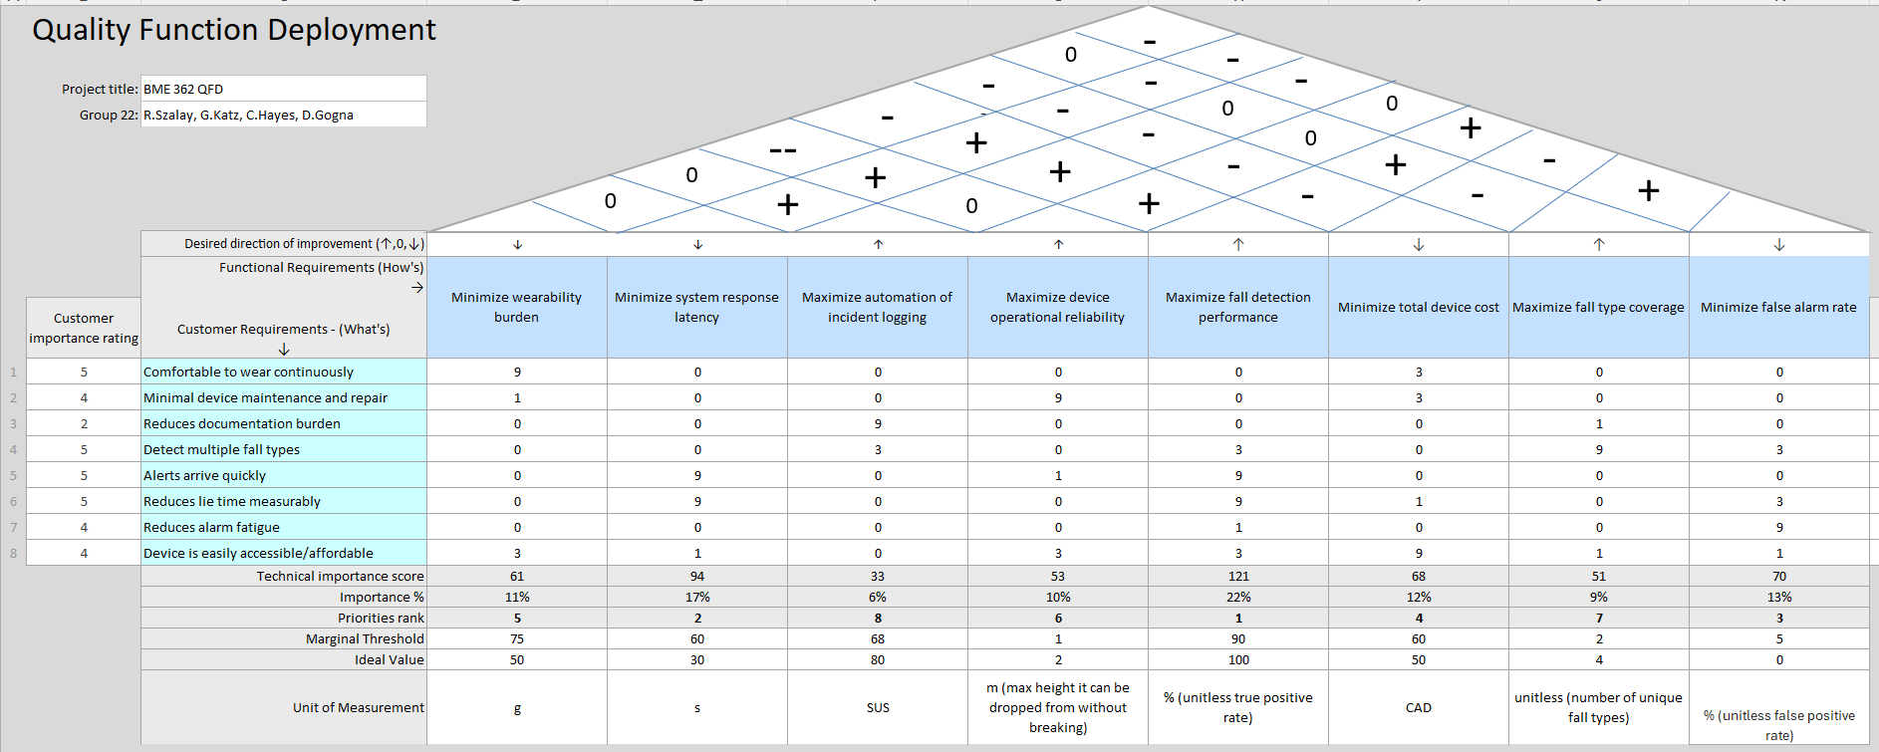
Critical Requirements, Functions, and Their Associated Specific
[5][9]
[5][6][7]
[5][7][8]
[5]
[5][9]
[5][10][11]
[9]

Slide 3
References
[1] X. Yao, A. S. Champagne, S. R. McFaull, and W. Thompson, “Temporal trends and characteristics of fall-related deaths, hospitalizations and emergency department visits among older adults in Canada,” Health Promotion and Chronic Disease Prevention in Canada, vol. 44, no. 11/12, pp. 482–487, Nov. 2024, doi: https://doi.org/10.24095/hpcdp.44.11/12.04.
[2] Centers for Disease Control and Prevention, “Older adult falls data,” Older Adult Fall Prevention, Oct. 28, 2024. https://www.cdc.gov/falls/data-research/index.html
[3] J. Kubitza, I. T. Schneider, and B. Reuschenbach, “Concept of the term long lie: A scoping review,” European review of aging and physical activity : official journal of the European Group for Research into Elderly and Physical Activity, https://pmc.ncbi.nlm.nih.gov/articles/PMC10463813/ (accessed Nov. 3, 2025).
[4] R. and, “Senior Care Technologies Market - Forecasts from 2025 to 2030,” Researchandmarkets.com, 2025. https://www.researchandmarkets.com/reports/5926867/senior-care-technologies-market-forecasts?srsltid=AfmBOoqjPL22tO8ABvKK583hOHbJpyJJWzrhCc8Qv2LZ5BrxN4LKXYRh (accessed Oct. 07, 2025).
[5] Engineers working at miAlert (geriatric healthcare company), who provided insight on user needs, engineering requirements and specifications (product weights, false/true positive rates, technological issues)
[6] Residents from Scarborough Retirement Residence, providing insight on various user needs pertaining to the patient (comfortability, etc.)
[7] Staff (Caregivers) from Scarborough Retirement Residence, providing insight on various user needs (fatigue, alarm rates, etc.)
[8] S. Colaianni, “5 Best Medical Alert Systems of 2025,” Ncoa.org, Jul. 25, 2025. https://www.ncoa.org/product-resources/medical-alert-systems/best-medical-alert-systems/ (accessed Nov. 05, 2025).
[9] R. Igual, C. Medrano, and I. Plaza, “Challenges, issues and trends in fall detection systems,” BioMedical Engineering OnLine, vol. 12, no. 1, p. 66, 2013, doi: https://doi.org/10.1186/1475-925x-12-66.
[10] Staff (Administrative/Care Director) from Scarborough Retirement Residence, providing insight on various user needs (fatigue, alarm rates, etc.)
[11] B. Tran, “Wearable Health Tech Costs: What Consumers Pay,” PatentPC, Mar. 09, 2025. https://patentpc.com/blog/wearable-health-tech-costs-what-consumers-pay

